Slide 1

SQL Challenge 4
Finance Analysis

Slide 2


Slide 3
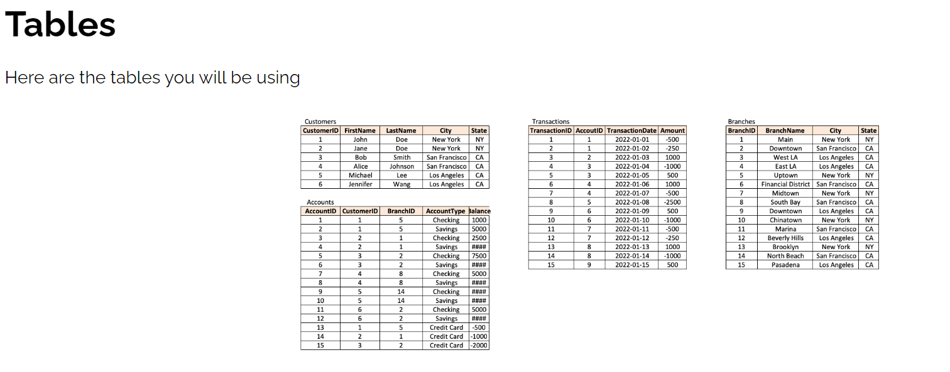

Slide 4
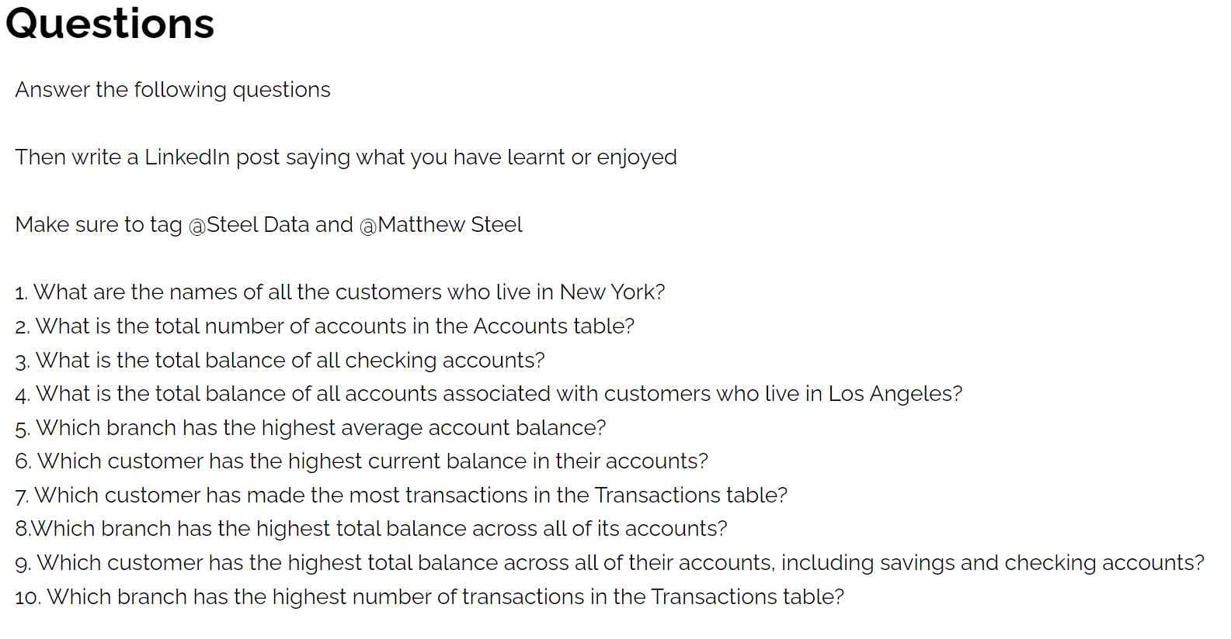

Slide 5
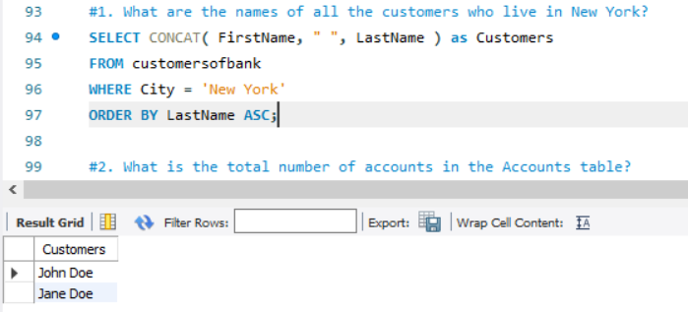

Slide 6
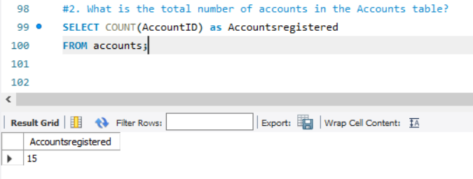

Slide 7
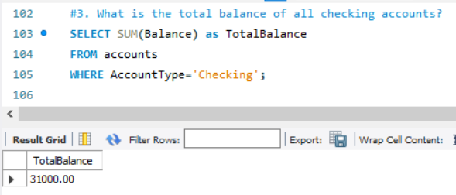

Slide 8
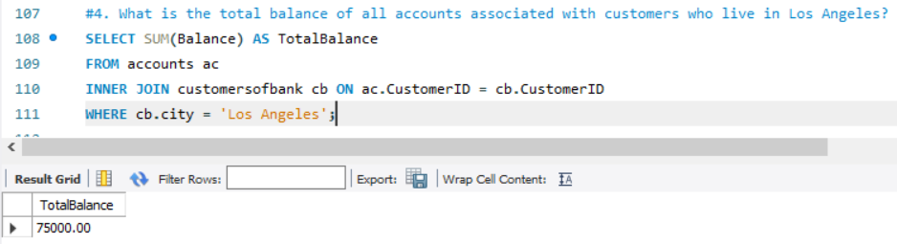

Slide 9
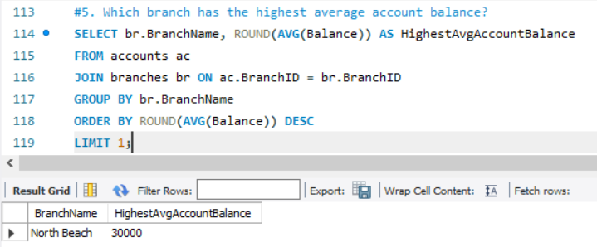

Slide 10
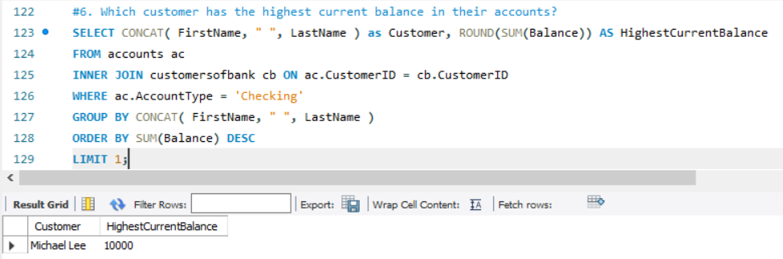

Slide 11
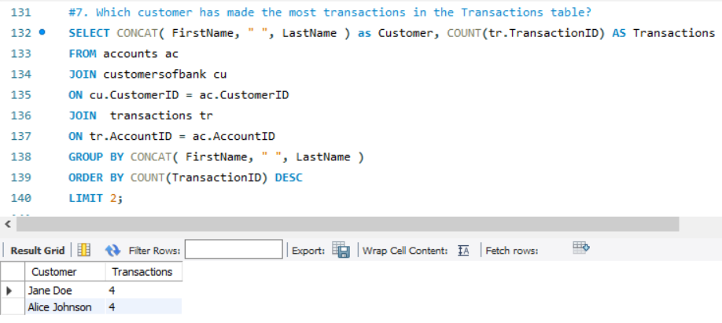

Slide 12
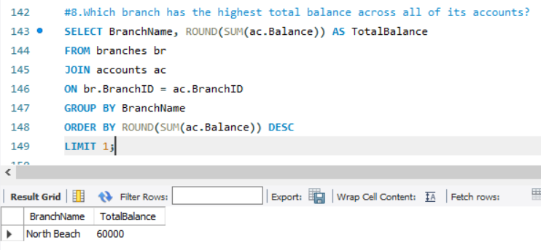

Slide 13
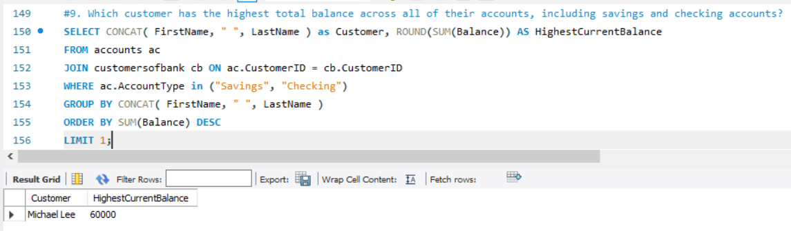

Slide 14
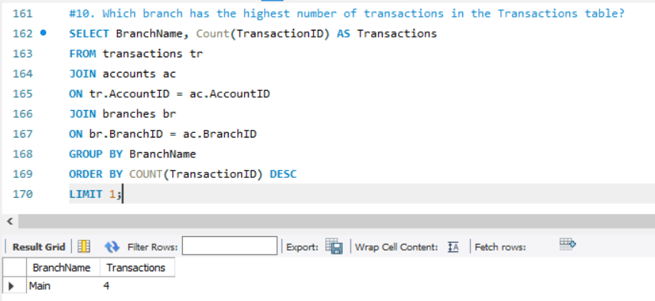

Slide 15
INSIGHTS
15 Accounts were registered.
The total balance of all checking accounts is 31000
North beach is the branch with the highest total balance out of the branches registered.
Main is the branch where most of transactions were made.
Michael lee is the customer with the highest total balance.
LOS Angeles happened to be the city with the highest total balance.

